Slide 1

Employee Management System .
Under the guidance of Ms. Tandra

Slide 2
Group Members
1.Akasha K R
2.Gaurav
3.Apurva
4.Alisha
5.R.Mamatha

Slide 3
CONTENTS
1.INTRODUCTION
2.SOFTWARE REQUIREMENTS
3.SUBJECTS USED
4.STEPS OF PROJECT
5.DATABASE
6.SCREENSHOTS
7.FUTURE SCOPE

Slide 4



INTRODUCTION

Slide 5


Slide 6
SOFTWARE REQUIREMENT
1.OPERATING SYSTEM: WINDOWS
2.SQLITE DATABASE
3.VISUAL STUDIO

Slide 7
SUBJECTS USED
1.Object Oriented Programming using C++
2.Database Management System

Slide 8
STEPS OF PROJECT
Step 1: Install Visual studio and DB browser
Step 2: Open visual studio and create new project.
Step 3: Install the required c files in the Source Files.
Step 4: Include various Libraries such as “sqlite3.h” , “string” , “stdlib” , “iostream”
Step 5: create various functions for creating the table , inserting the data , deleting the data , updating the data , show all data , clear all data.
Step 6: include the c++ code and various queries for corresponding operations.

Slide 9
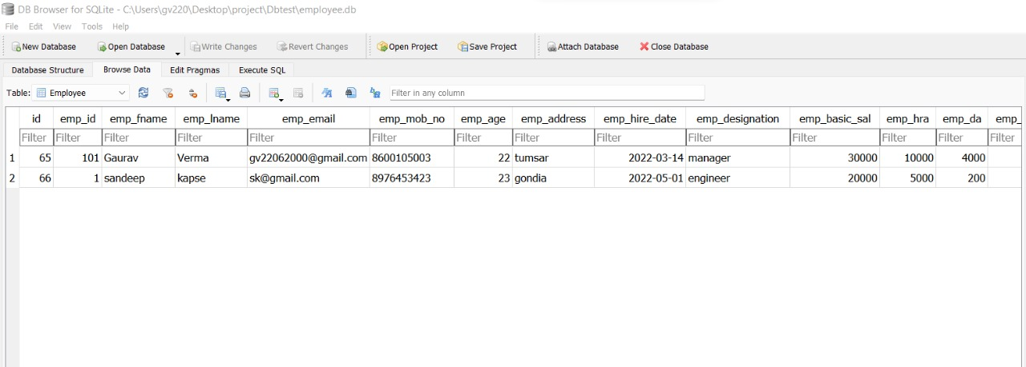
DATABASE

Slide 10
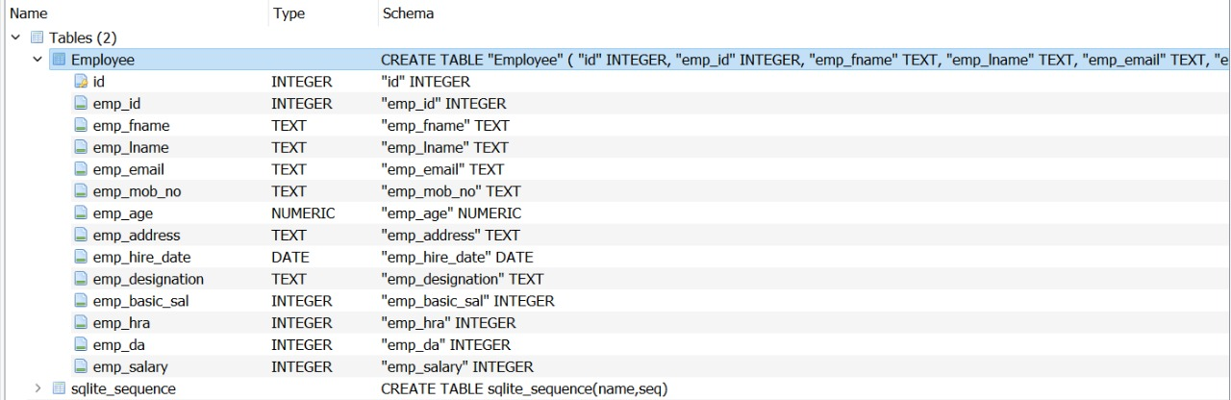
SCREENSHOT

Slide 11
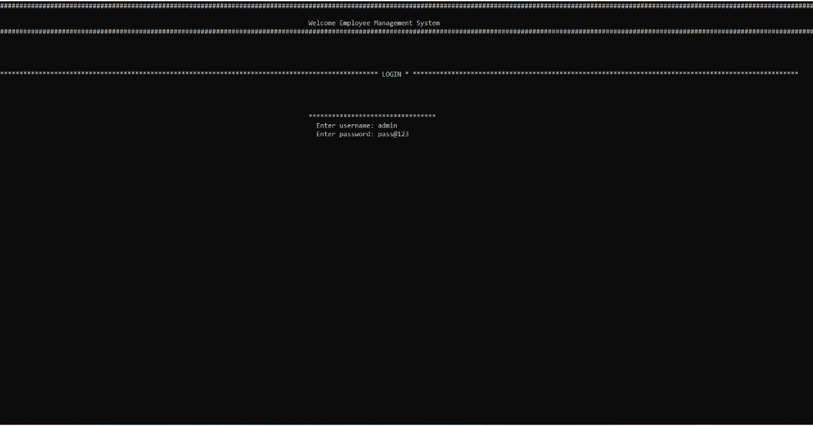

Slide 12
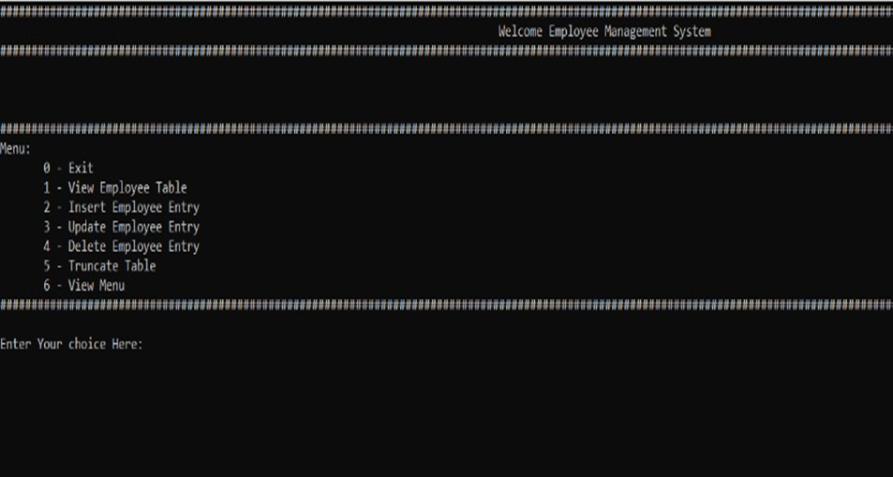

Slide 13
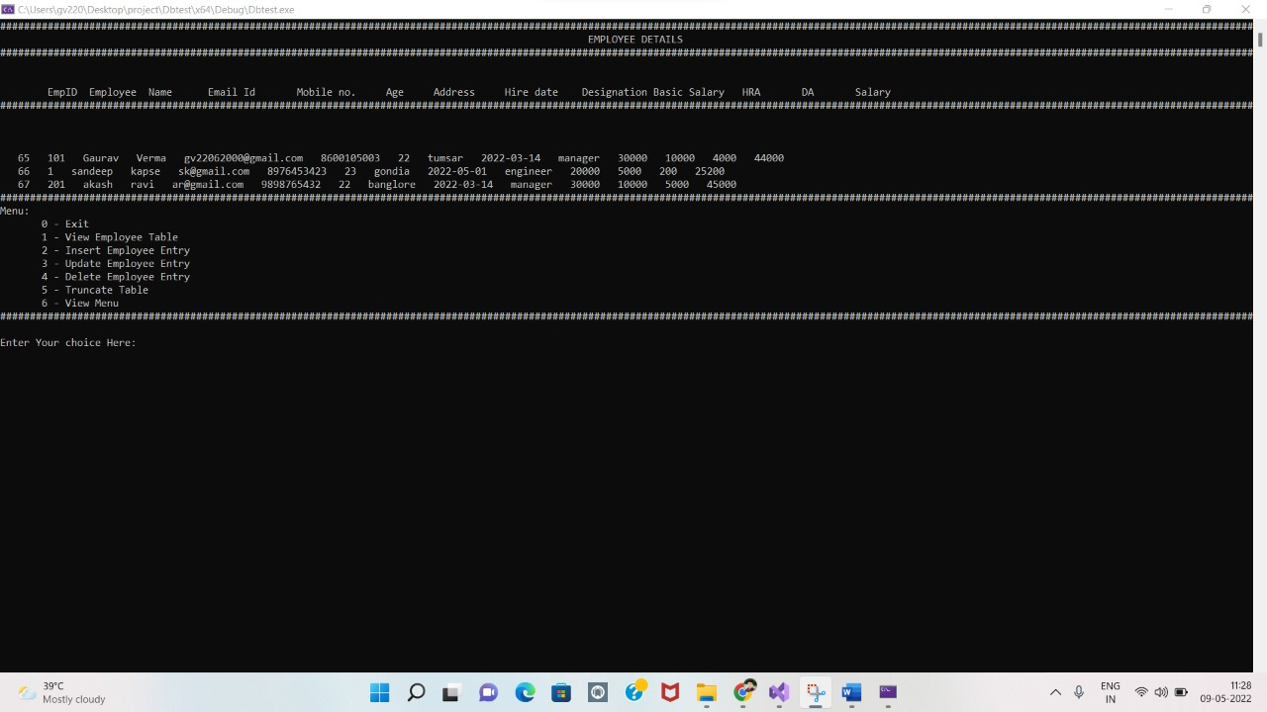

Slide 14
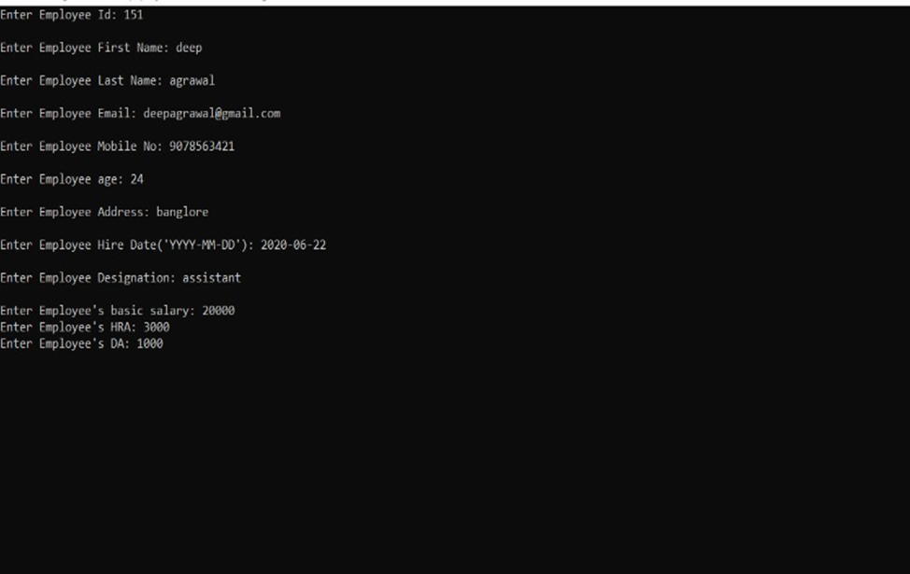

Slide 15
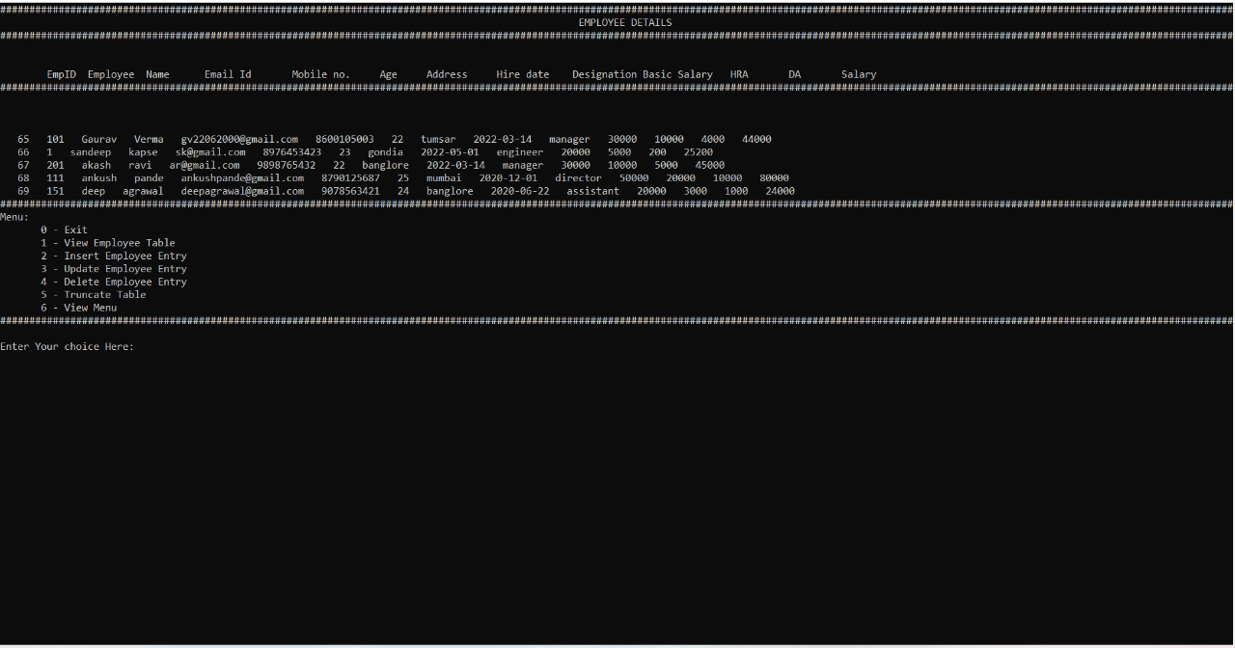

Slide 16
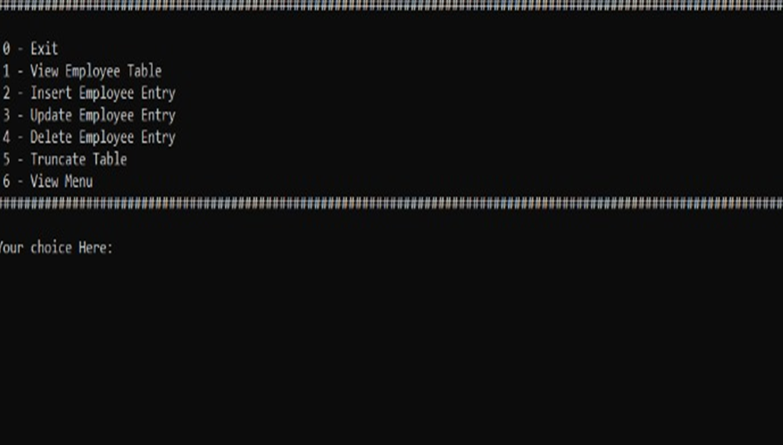

Slide 17
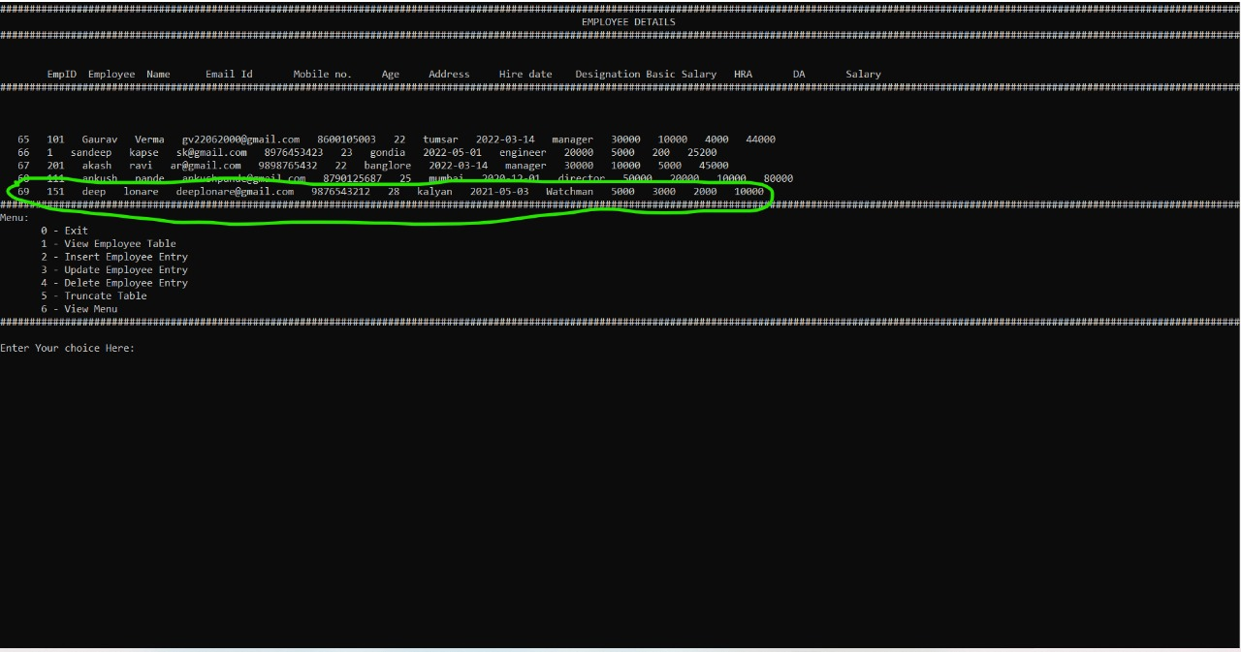

Slide 18
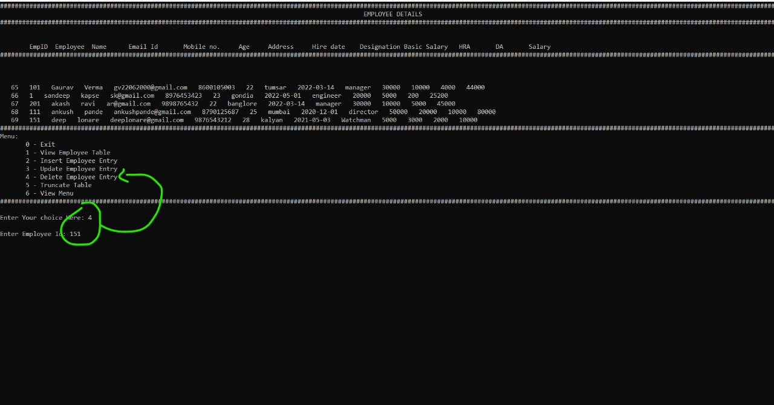

Slide 19
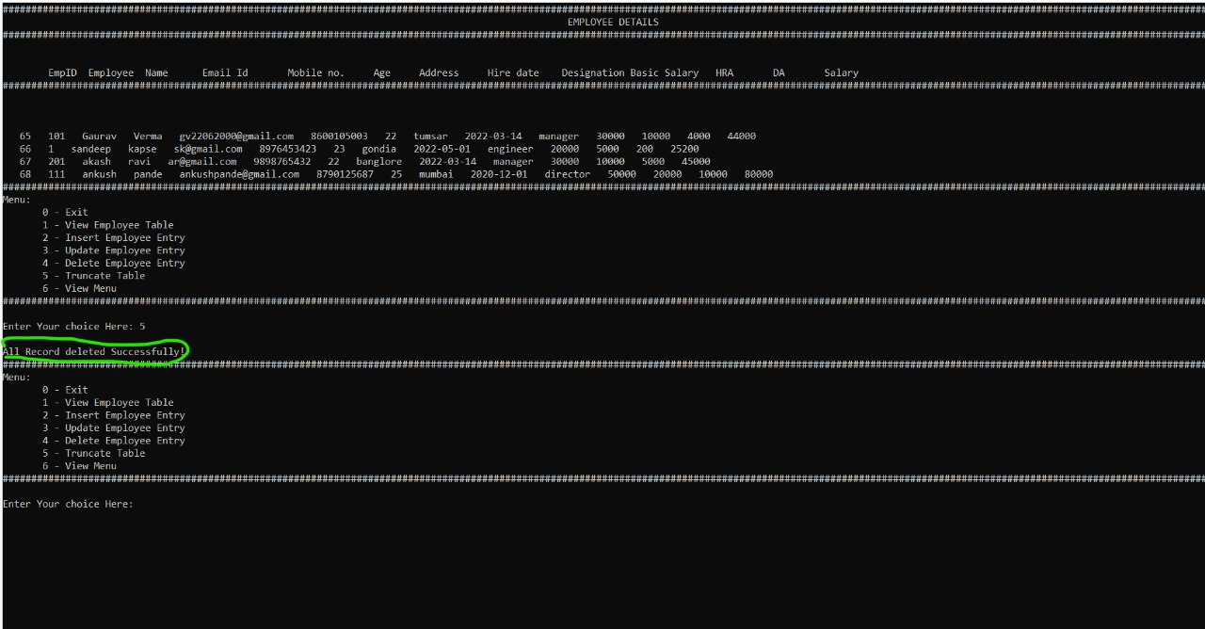

Slide 20
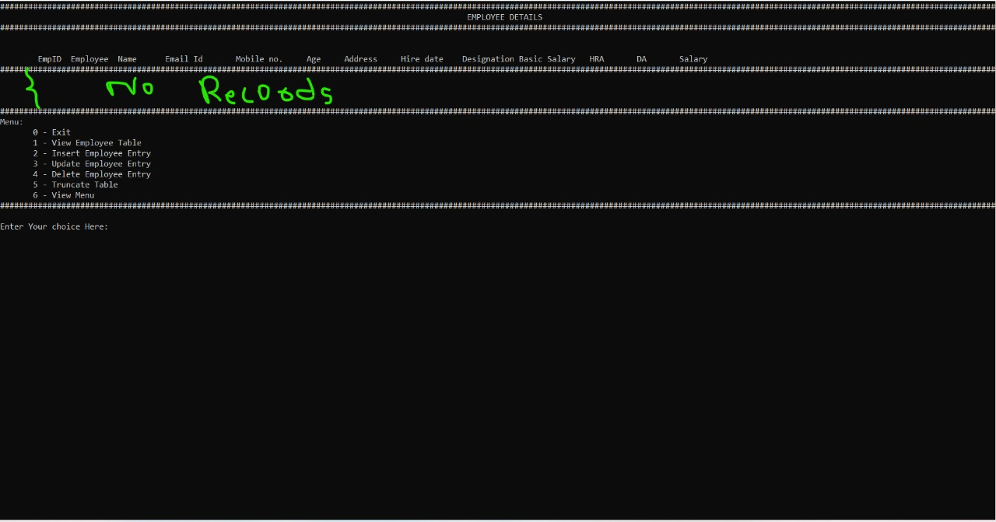

Slide 21
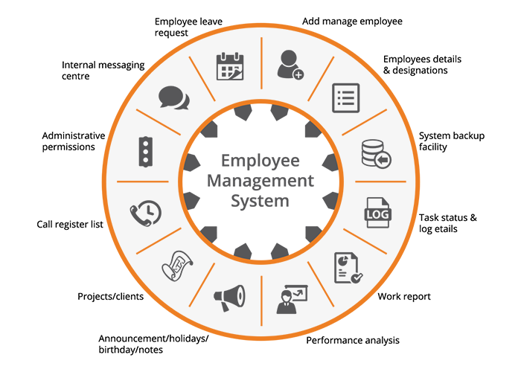
FUTURE SCOPE

Slide 22
Future scope
1.Future scope can be to print the records In future.
2.Also we can add a leave structure in the future.
3.Can implement a regular backup mechanism to backup the employee database to avoid disasters.
4.The system can be developed in such a way that its existing features can be modified to better versions .
5. We can use this mechanism for other system for example student data management system.

Slide 23


